Slide 1
Holistic backup solution with industry-defining backup and recovery speed
storage2day 2021

Slide 2
Agenda
01
StarWind Intro
4
02
Challenges of typical Backup Infrastructure
8
03
StarWind Backup Infrastructure
11
04
11
Fully preconfigured Backup Appliance covered with 24/7/365

Slide 3
StarWind Intro
10 500
servers
17
years
1st
vendor
StarWind Software installed on more than 10k servers over the world
StarWind is a virtualization pioneer with 17 years in this space
One of the 1st vendors to offer Software-Defined Storage and Hyper-Convergence
(2005 and 2008 respectively)

Slide 4
Challenges of typical Backup Infrastructure
02

Slide 5
Business challenges with backup
Traditional backup systems take significant time to perform a backup and, consequentially, require even more to restore it
Aligning data backup needs with application architecture requirements
Ensuring reliably scheduled backups
Production environment remains idle during the time wasted on slow backups

Slide 6
StarWind Backup Infrastructure
03

Slide 7
Our approach
Fully pre-configured backup solution designed as per your specific
Near-to-instant restores allowing to fit even the strictest RTO and RPO requirements
Transparent and future-proof architecture combining the best commodity hardware, an industry-standard hypervisor of your choice, and a StarWind SDS engine
Segregated backup storage and backup application layers with smart storage connection
Protection against drive failure by employing erasure-coding technologies
Notes:
StarWind Backup Appliance is designed as a turnkey solution to easily fit into your existing backup infrastructure or build/replace the existing one. It’s main building block is the fast NVMe storage that stays behind the fast backups and restores. The appliance comes completely prebuilt so you just need to connect it to your environment and start performing the backup jobs.
The Backup Appliacne has two models – 30 and 60TB but the storage size can be tuned as to your specific requirements.
Of course, it also come with StarWind Premium Proactive Support that monitors the Appliance 24/7/365 and makes sure the backups are running smoothly.
So what you get is first of all extremely fast backups and restores (basically, strict RTO and RPO requirements are no longer something that is hard to meet) so you can be sure to get your data back fast in the worst case scenarios.
Since we use NVMe storage, the backups no longer take long time as it was with HDDs so you don’t need to plan for backup windows and waste your production resources that remained idle during backups – you can now use it to work for your business.
Now, let’s actually take a look at the architecture.

Slide 8
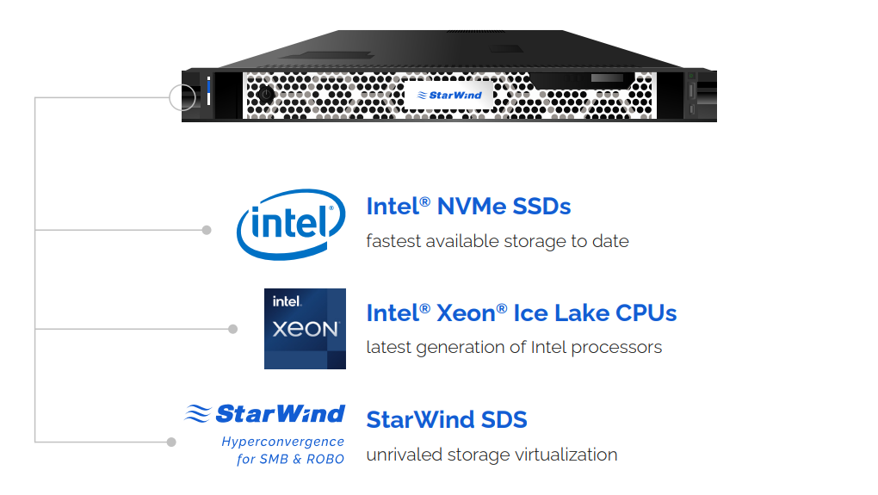
StarWind Backup Appliance

Slide 9
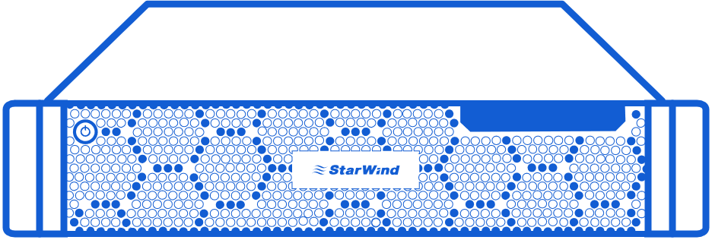
StarWind BA Architecture
Production Infrastructure
StarWind BA
Backup

Slide 10
Key benefits
Blazing-Fast Backups
Ultra-Fast Restores
StarWind BA eliminates the need in trying
to schedule backup windows as well as any
dependency of fast production environment
on slow backup systems
StarWind BA allows you to fit even
the strictest RTPO requirements and makes
sure your workloads will perform as fast
as possible even during critical events
Omni-Compatibility
The solution will perfectly fit into your existing
backup infrastructure or become a basis
for a new one without any hardware, hypervisor,
or backup software restrictions
Notes:
StarWind Backup Appliance is designed as a turnkey solution to easily fit into your existing backup infrastructure or build/replace the existing one. It’s main building block is the fast NVMe storage that stays behind the fast backups and restores. The appliance comes completely prebuilt so you just need to connect it to your environment and start performing the backup jobs.
The Backup Appliacne has two models – 30 and 60TB but the storage size can be tuned as to your specific requirements.
Of course, it also come with StarWind Premium Proactive Support that monitors the Appliance 24/7/365 and makes sure the backups are running smoothly.
So what you get is first of all extremely fast backups and restores (basically, strict RTO and RPO requirements are no longer something that is hard to meet) so you can be sure to get your data back fast in the worst case scenarios.
Since we use NVMe storage, the backups no longer take long time as it was with HDDs so you don’t need to plan for backup windows and waste your production resources that remained idle during backups – you can now use it to work for your business.
Now, let’s actually take a look at the architecture.

Slide 11
Key features
Enhanced Data Safety
Easy to Start and Use
Segregates backup storage and backup
application layers with smart storage
connection and protects against drive failure
by employing erasure-coding technologies
StarWind Backup Appliance comes as a fully
pre-configured backup solution designed
as per your specific requirements and is easily
operated through a Web UI
Transparent Architecture
ProActive Premium Support
The transparent and future-proof architecture combines the best commodity
hardware, an industry-standard hypervisor
of your choice, and a StarWind SDS engine
We will make sure that your backups are
always performed successfully and no issues
remain unnoticed, monitoring the status
of your backup infrastructure 24/7/365
Notes:
StarWind Backup Appliance is designed as a turnkey solution to easily fit into your existing backup infrastructure or build/replace the existing one. It’s main building block is the fast NVMe storage that stays behind the fast backups and restores. The appliance comes completely prebuilt so you just need to connect it to your environment and start performing the backup jobs.
The Backup Appliacne has two models – 30 and 60TB but the storage size can be tuned as to your specific requirements.
Of course, it also come with StarWind Premium Proactive Support that monitors the Appliance 24/7/365 and makes sure the backups are running smoothly.
So what you get is first of all extremely fast backups and restores (basically, strict RTO and RPO requirements are no longer something that is hard to meet) so you can be sure to get your data back fast in the worst case scenarios.
Since we use NVMe storage, the backups no longer take long time as it was with HDDs so you don’t need to plan for backup windows and waste your production resources that remained idle during backups – you can now use it to work for your business.
Now, let’s actually take a look at the architecture.

Slide 12
Complete solution
StarWind Backup Appliance is a holistic backup solution that provides extensively increased backup infrastructure longevity by being more resilient and consuming less power while ensuring unprecedented speed of restores for files and VMs of any size, making it a smart and highly cost-efficient investment
The backup storage is logically separated from the backup software to increase security and is connected only once the backup job is started.

Slide 13
Use cases
StarWind All-NVMe Backup Appliance will become the perfect fit for those Enterprise ROBO, SMB, and Edge that are looking to simplify their backup process administration, reduce their backup window, and be able to restore any file unprecedentedly fast

Slide 14
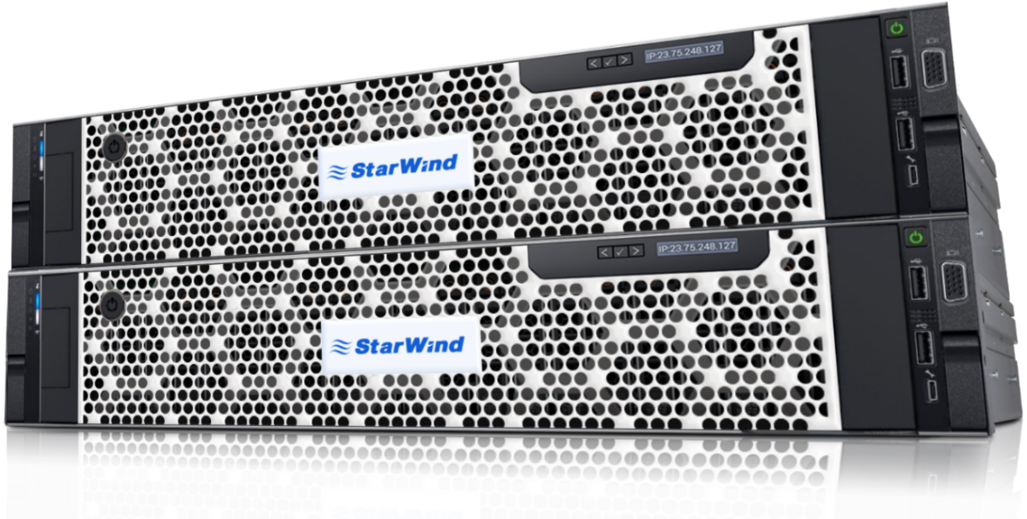
StarWind HCA enables a complete infrastructure
Value Differentiators:
High Performance: Optane powered caching combined with a “cold” tier of read-intensive or mix-use SSD offers performance that meets any requirements
Rapid Deployment: StarWind HCI removes the burden of configuration, application migration, and integration, featuring free migration assistance and industry-leading tech support
Designed for Business Needs: The combination of Preconfigured HCAs and Backup Appliances are built specifically for the needs of the small-to-medium enterprises (SME) and remote or branch offices of larger organizations and enable a complete infrastructure solution.
Notes:
Great! With all that taken into account, I’d like to mention that all of our appliances are able of providing a wide array of options with different redundancy levels, compute power and storage capacities. ​
​
Since our main goal is to provide an extremely flexible, feature rich, turn-key solution that can meet any company’s needs, we continuously update our product line, and in the process, pinpoint the sweet spot between storage efficiency and performance.​
​
In result, we’ve created a simplistic and at the same time cost-efficient solution, which is achieved with the right combination of proprietary storage technologies, low hardware footprint and flexibility.​
​
The StarWind HCA, is delivered as a turnkey solution that easily integrates within your existing virtualized, non-virtualized infrastructures or if necessary – is able of replacing it completely!​
​
Our flexibility will allow you to configure a solution that will be tailored specifically towards your individual requirements, instead of confining you to a model that could be either out of budget, overkill or simply not technologically sufficient.​
​
A perfect example would be the current cost of an All-Flash solution. From the early days of SSD's we balanced cost and redundancy with RAID5 instead of a RAID10 deployments. Now, our latest HCA model line include different SSD types - looks like times have changed.​
​
We've had a numerous amount of clients that were shocked by the price of their solution. Don’t get me wrong … they were shocked in a good way!​
​
None the less, due to our philosophy, we still offer solutions that would be a best fit for any demand. ​
​
By the way… our model line is based on 2 types of solutions: ​
Value Flash, which is an all-flash solution with Read Intensive SSDs. The ones that allow us to conquer with the spindle drives costs.
Performance Flash, which is a truly high performing all-flash solution and is ready to, literally, “send” all those performance-hungry applications of yours into IOPS space
​
And just in case you are wondering, the amount of usable storage in our pre-configured standard appliances ranges from 2.8 to 37.6TB.​
​
The support of our solution is based on a single support umbrella for all of its components. So in any case of encountering any issues with the cluster, you would just need to answer a single phone call for the resolution of any issues.​
​
All of our hardware solutions are built from the best of breed components, fully configured to your needs, and even stress tested before shipping.​
​
So, the only thing left for you to do, is rack the appliances, connect them to the power and network, and start deploying VMs. Which in return, will save you countless hours typically spent on configuration and fine-tuning.​
​
All of this adds up to minimize the amount of IT management, resources and attention that would have been required for the support of your infrastructure.​
​
In this case, you can rely on us to - not only deliver our solution, but to support it proactively, which in return, will increase its uptime and could decrease yours, by allowing you or anyone else responsible - to sleep at night knowing that the data is safe!​
​
…..​
​
***I mean, what more could you ask for? … Let me guess - Backup! Something that’s should never be taken for granted. ​
​
And for that reason in particular, another product in our hardware product line is – the StarWind VTL Appliance!***​

Slide 15
How to forget what it's like to have trouble with your infrastructure
04

Slide 16
StarWind ProActive Support
Traditional Support Systems include a numerous amount of stages between problem and resolution.
Issue
Administrator finds out something happened
Specification
Identification
Ticket creation
Waiting response
Fixing process
Involving 3rd party vendors
Resolution
Notes:
Once implemented, the last thing we’d want to do is leave it for you to support!​
​
It’s no secret, that infrastructure support, is the most important and times taking process that involves a fair amount of knowledge, human resources, escalation and task prioritization.​
​
Now... a traditional support chain includes a lot of aspects to be taken into account, that – simply turn it into a headache. That headache becomes even more acute, if the issue is complex which in return.... leads to consequences of (doing the last thing we'd ever want to do -) attracting third party vendors.​
​
The overall downtime of this process, results in a large gap of your company's profit, that may directly affect your business continuity. ​
​
Taken all of the possible stress into account, we think you’re better off delegating responsibilities of monitoring your infrastructure 24/7 to an automated solution, at the same time unloading your system administrators.​
​
It’s all made possible with our ProActive Support!​

Slide 17
What Changes with ProActive Support?
Customer’s Environment
Issue
StarWind Health Monitoring
(Realtime) Finding a solution
Involve 3rd party vendors if needed
Reach out for remote access
Solution
Support Team
Resolve issue
There is no need to even submit a support ticket for a resolution!
Notes:
The main goal behind the implementation of a system like our ProActive Support, is - eliminating any possible down time of your infrastructure in a timely manner. Now, don't get me wrong - not that there is no reason of that happening, but we’ll make sure to foresee any possible issues before they occur.​
​
We have spent a whole deal of attention in the development of our Analytical Reporting System that is able to inform our Support Team about any potential issues, allowing us to resolve them even way before they appear.​
​
So, what you ultimately get, is a solution - not a problem.​
​
So, with the ProActive Support taking its place in your infrastructure, the responsibility of infrastructure uptime - is our ballgame! You can safely consider it as Advil from any kind of your infrastructure support headaches.​
​

Slide 18
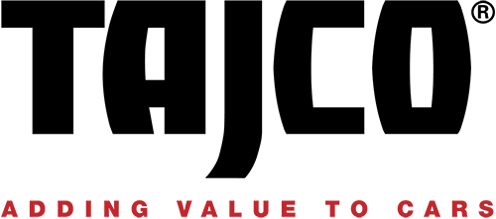
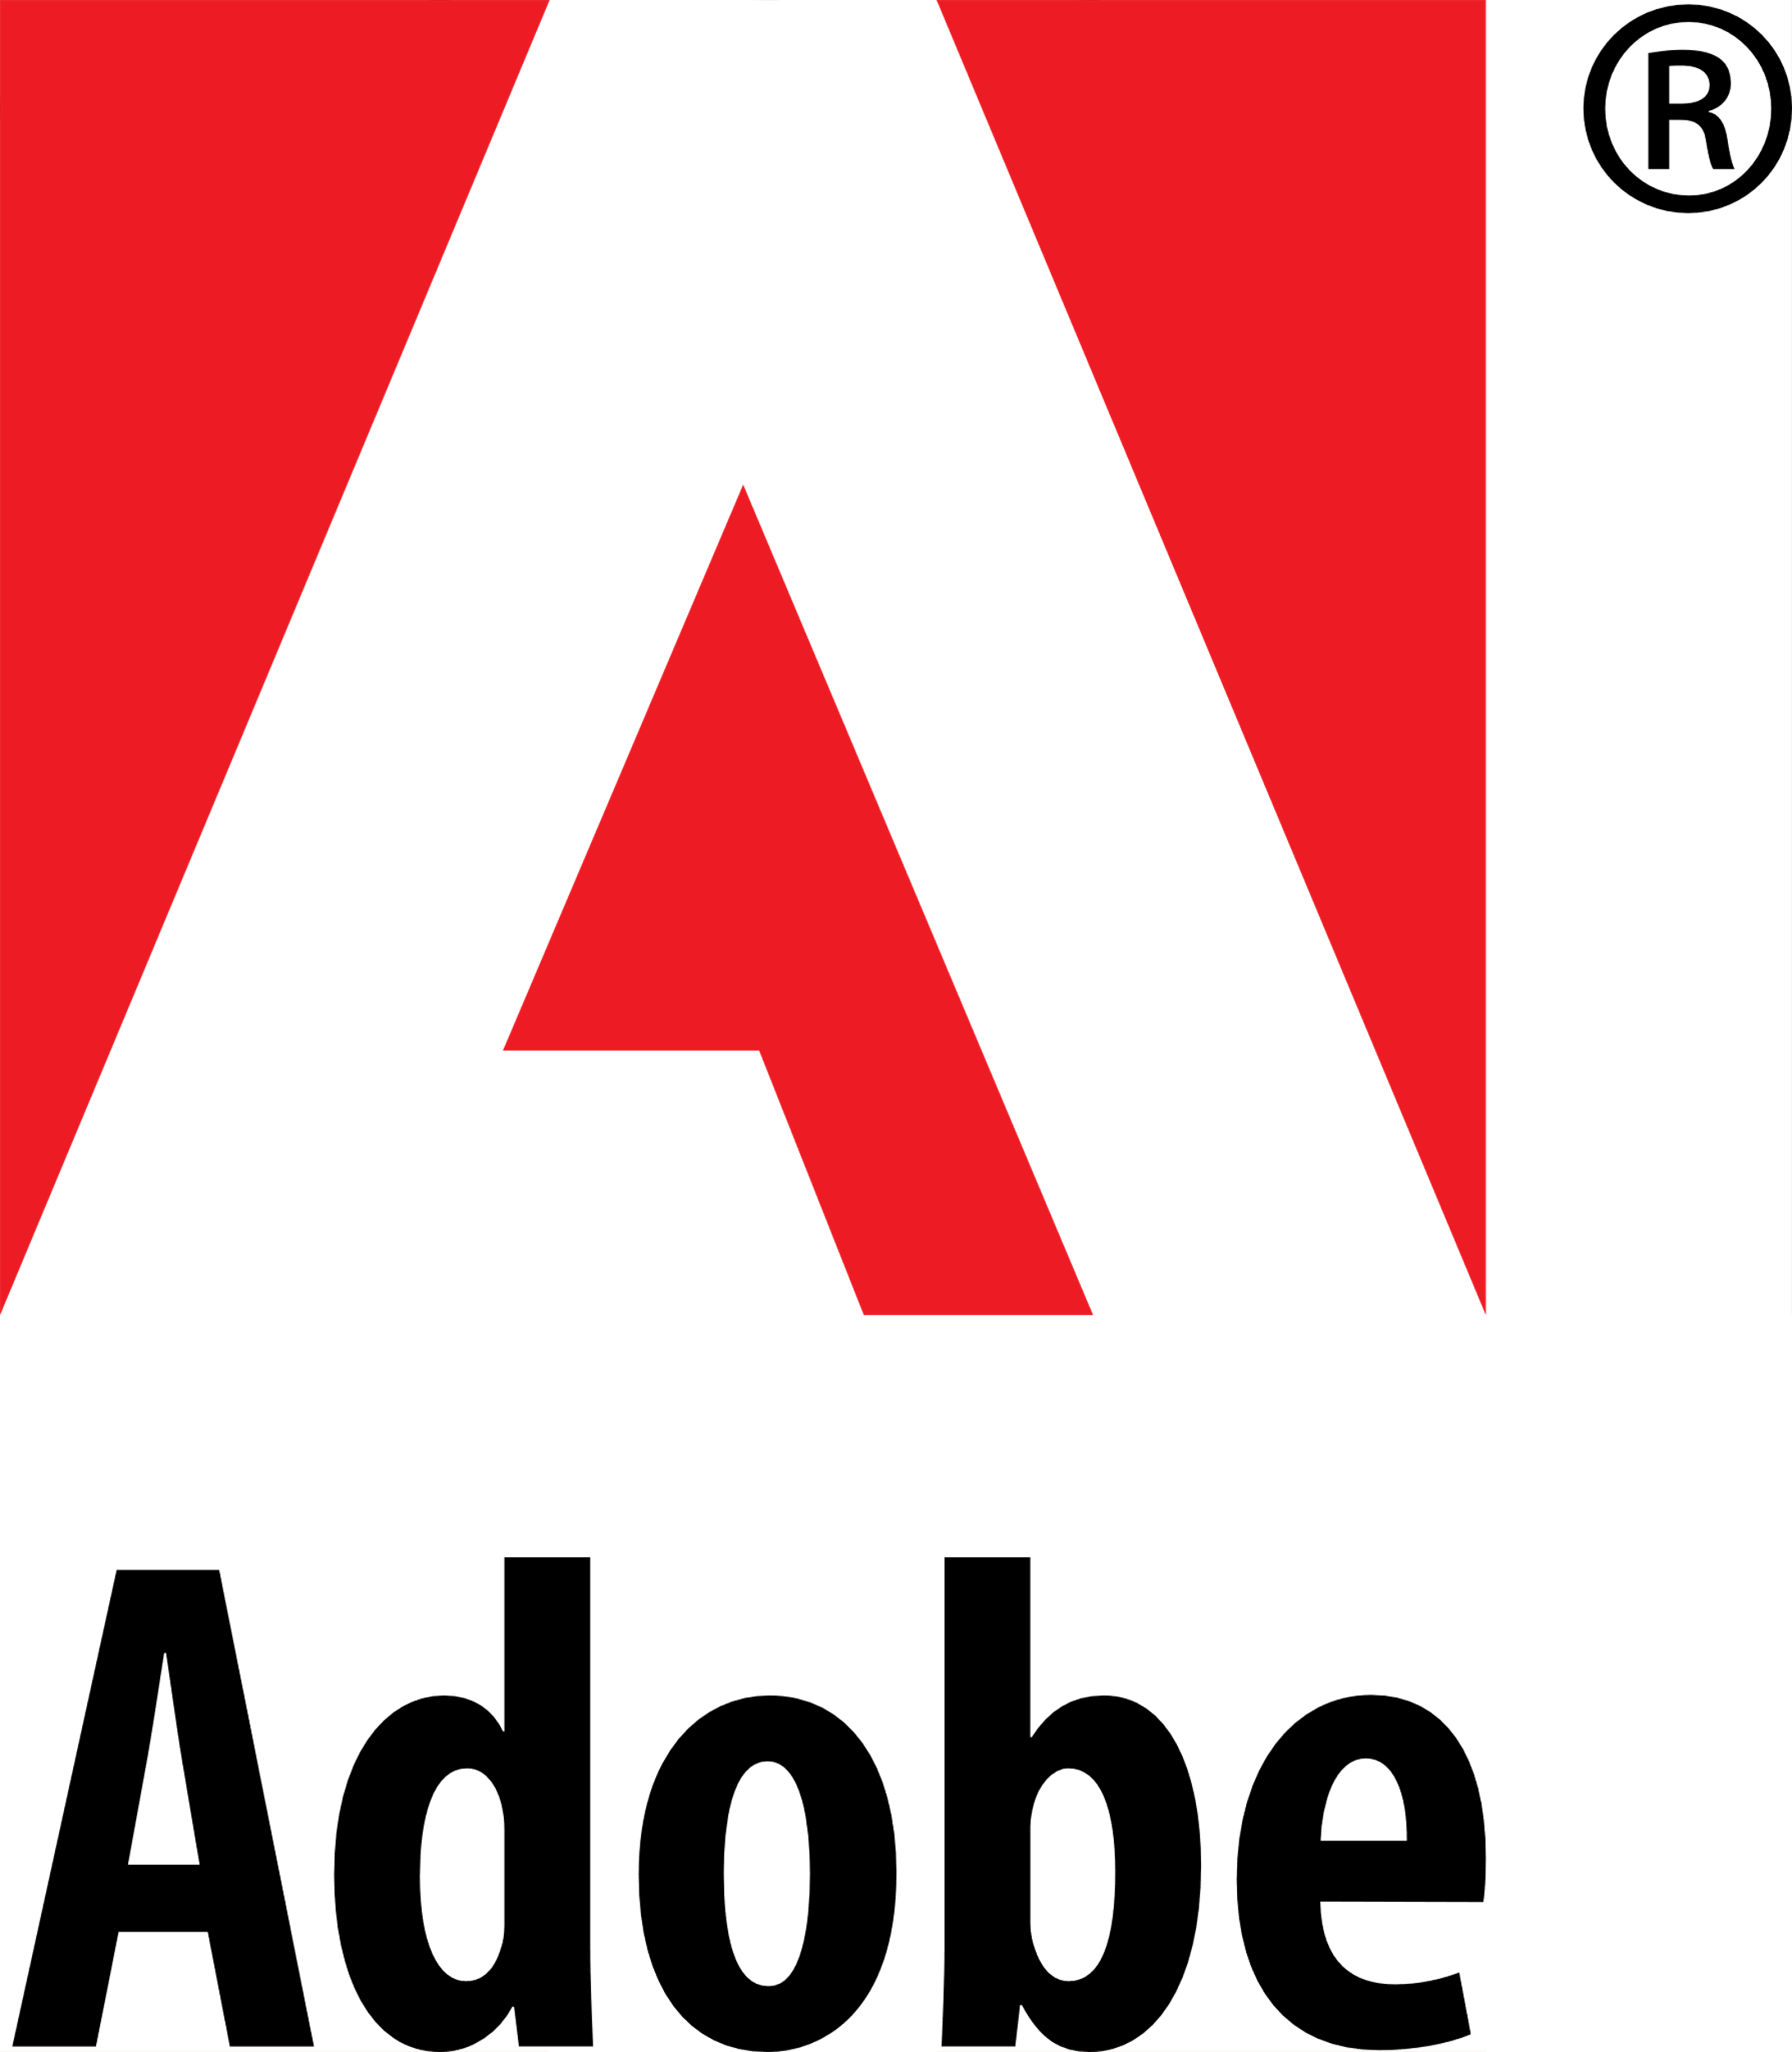
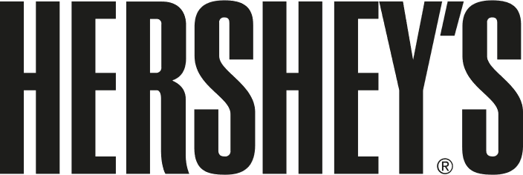
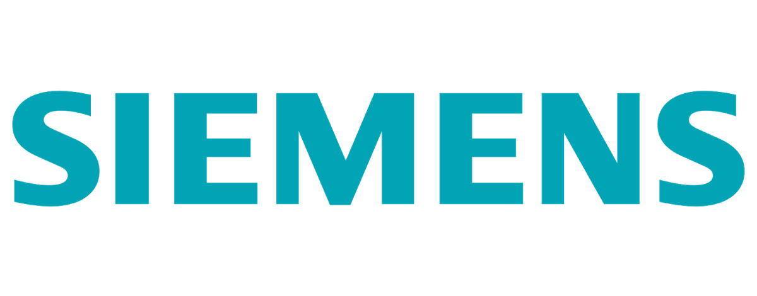
Our Customers
Notes:
I think you’re going to agree with me on this one, but we believe that the biggest improvement to any production is – it’s failure sustainability.
A typical production infrastructure, no matter - old or new, includes certain aspects, that… for different reasons haven't been foreseen.
Based on our experience of numerous implementations, we've come to know, that every client faces a fair share of difficulty when it comes to building a virtualized environment. The main reasons would include - management, the solutions complexity and the introduction of high costs.
The overall stability of a typical infrastructure, depends on the architecture limitations of the solutions deployed previously, multiple management methods involved, or the moment when any support was due… and a resolution is nowhere to be found.
As your existing infrastructure grows or ages, its evolution includes on-the-go deployments of additional compute hosts, switches and storage appliances. Which when done on the fly – create vulnerabilities.
A single failure of a component on any layer, can lead to consequences of limited accessibility to your mission-critical applications or data.
Since we have a variety of solutions and business continuity is not our only forte, we are capable of improving the uptime of your production, as well as covering your on-site, off-site, along with cloud back-up and disaster recovery needs.
This is the exact reason why we’re keen to analyze existing environments… where we would research the production you run, previous experience and the requirements of your project.
Can you tell us a bit more details about your existing infrastructure and the production you are running?
No High-Availability, possibilities of VM migration…. or any kind of virtual storage layer?
What kind of hypervisor? How many hosts? Amount of Usable Storage?
How many sites? Distance between them? How are they backed up?
Great!
So, lets cut to the chase by unveiling more details on our flagship product.

Slide 19
Thank You

